Slide 1
Honoring Service & Sacrifice
NH State Veterans Cemetery
VA Weekly Staff Meeting
January 23, 2023

Slide 2
Agenda
Overview
Overview of the NHSVC
  Layout & Staffing
  Eligibility
  Statistics
  NHSVC Community Outreach and Programs
Military Burials
ROE

Slide 3
Veterans Cemeteries
Initiative started to solve issue of properly honoring WWII vets
Standards are similar; execution and processes vary
Typically offer three types of burials
  Full-casket in a pre-placed outer burial container with upright or flat headstone
  In-ground cremated remains with upright or flat headstone
  Columbarium niche inurnment with plaque or niche cover marker
  Some veteran cemeteries offer scatter gardens for cremated remains
  A few offer green burials—VA is supportive of adding more green burial areas
Most only offer a brief committal service. Many require using a committal shelter or chapel. Some allow graveside services
No cost for veteran burials. Dependents may have a fee for burial.

Slide 4
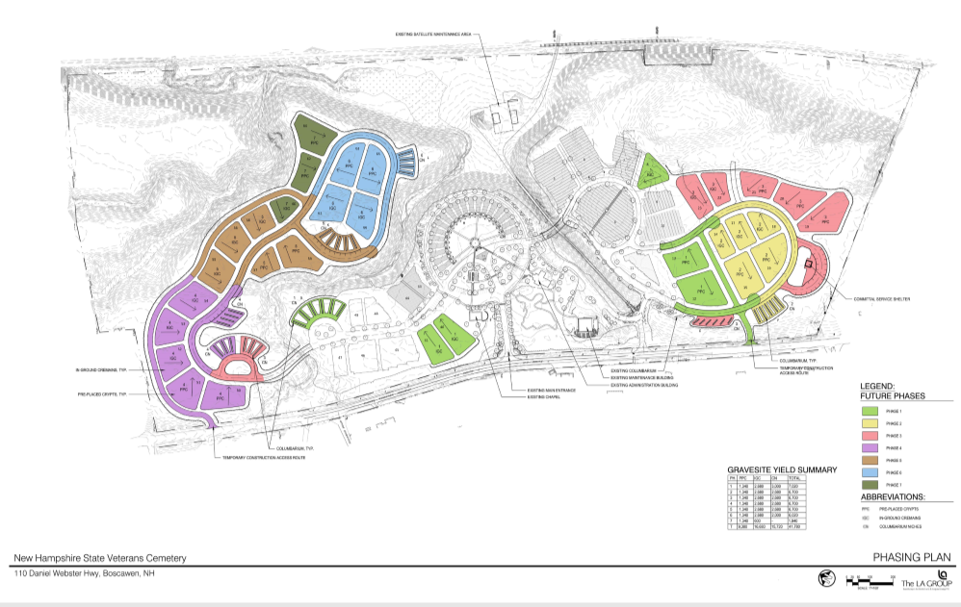
Overview
104 Acres Total
19 acres developed
58 acres “usable”
Space until at least FY93
Opened in 1997
Staff
Director (1)
Maintenance Foreman (1)
Grounds Maintenance (4)
Cemetery Rep (1)
Admin (2)
Seasonal PT Grds Maint (2)
PT Admin (1)
Latest Expansion:
- 1,410 Double–depth OBCs
- 1,862 IGC

Slide 5
NHSVC Overview
State facility staffed by state employees
Follow National Cemetery Administration (NCA) guidelines (part of the Veterans Administration (VA)). NCA compliance reviews done every three years.
Eligibility:
  No state residency requirement
  Service Requirement:
    Active-duty
      Any person who entered as an enlisted person on or before 9/7/1980 or as an officer commissioned or entered active-duty on or before 10/16/1981
      Any person who enlisted after 9/8/1980 or commissioned as an officer or entered active-duty after 10/16/1981 AND completed 24 consecutive months of service or the full period for which called/ordered to active federal duty.
    Selected Reserve
      Served at least one term of enlistment or, in the case of an officer, the period of initial obligation, or were discharged for disability incurred or aggravated in line of duty or died while a member of the Selected Reserve.
  Honorable or general discharge; other discharges are evaluated on a case-by-case basis. Dishonorable or Bad Conduct discharges are disqualifying.
All military veterans are encouraged to apply and let the NHSVC make an eligibility determination

Slide 6
NHSVC Overview (cont.)
Burial is a VA benefit for eligible veterans—there is typically NO CHARGE for a veteran burial
  VA provides NHSVC a “plot allowance” for veteran interments (amount is updated each October)
    Selected Reserve veterans who are non-residents of NH at the time of death will be charged an interment fee that is equal to the VA plot allowance rounded up to the nearest $50 increment.
  Benefit includes 20-minute committal service, interment, and headstone or niche marker
  Spouse of veteran is eligible for burial, even if the veteran is not interred at the NHSVC (or any veteran cemetery)
  Dependent children, including adult children not able to live independently, are also eligible for burial in the NHSVC
  NHSVC charges a $350 fee for dependent burial fee—due on the date of burial
VA plot allowances and dependent burial fees cover approximately 75% of the annual operating expenses
Veterans Cemetery Grants Program funds cemetery expansions or upgrades
Offer full casket, in-ground cremains (granite headstone), and columbarium niche burials (bronze plaque)
  Added pre-placed Outer Burial Containers for full-casket burials in 2019
  Estimated land usage ratio (measured in plots): 1 FC = 3 IGC = 240 Niches

Slide 7
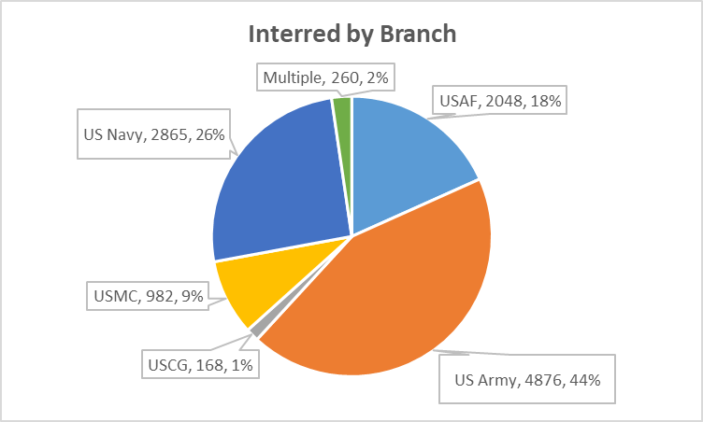
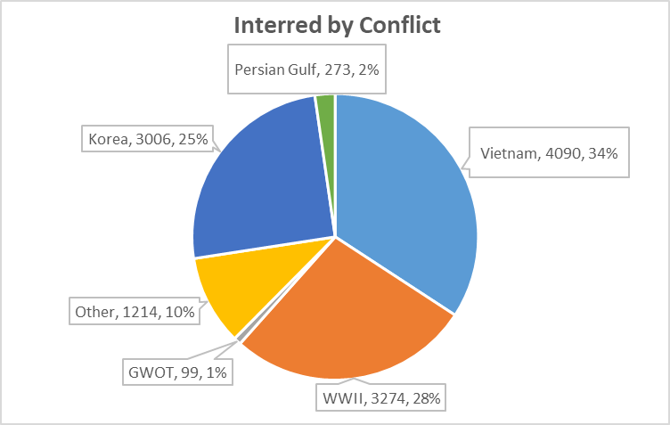
NH State Veterans Cemetery
Statistics as of 6/30/2022
14,728 total interred
  10,687 veterans
  4,041 non-veterans
260 served in multiple branches
28 US Merchant Marines (not pictured)
4 Canadian Military (not pictured)
13 KIAs
41 ex-POWs
865 served during two conflicts
199 served during three conflicts
Other includes Lebanon, Panama, Kosovo, Syria, None
Note: numbers will not add up because of counting the same veteran multiple times for branch or conflict.

Slide 8
NHSVC Highlights
Memorial Walkway
CSM Stanley & Renate Arnold Veterans Heritage Learning Center
20-points of NH Military History
Chapel
Gazebo
Events & Volunteer Opportunities

Slide 9
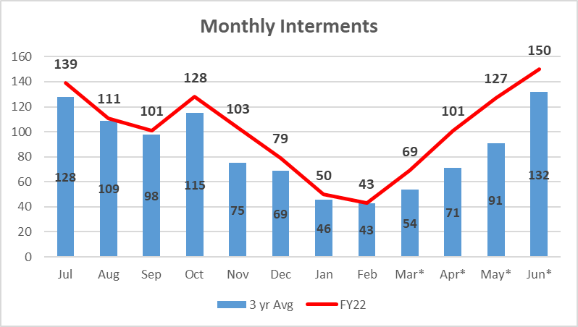
NHSVC – FY22 Overview

Slide 10
Programs that Support and Enhance the NHSVC
NH Veterans Cemetery Association
  Veterans Heritage Learning Center
  Memorial Walkway
  Trees for Boscawen
  Noise Reduction Berm
100 Nights of Remembrance
Wreaths for Boscawen
Standing With Fallen Comrades
Adopt-a-Garden
Burial Equity for Guards and Reserves (signed into law March 2022)
Headstone Cleaning and Memorial Walkway Clean-up Events
Communication – Rally Point, email updates, social media, website

Slide 11
Military Burial
Each state and branch of service do things a little different
Eligibility for honors may differ from eligibility for VA benefits
At a minimum, eligible veterans should have:
  TAPS played at service
  2-person military flag-fold detail
Firing details are NOT typically provided
  Retired senior officers and NCOs may get firing detail if resources are available
  Veteran Service Organizations (American Legion, Veterans of Foreign Wars, etc. often perform firing details upon request)
  Firing detail consists of three volleys
  Rounds from firing detail are usually presented to the next-of-kin

Slide 12
Veteran Burial Entitlements
Flag
Military Honors
  Differs by branch of service and state
Headstone, marker, or medallion
Death Benefit (to help defray burial costs)
  Apply AFTER death of veteran
Plot allowance
  Apply AFTER death of veteran
All information located at www.va.gov/burials-memorials

Slide 13
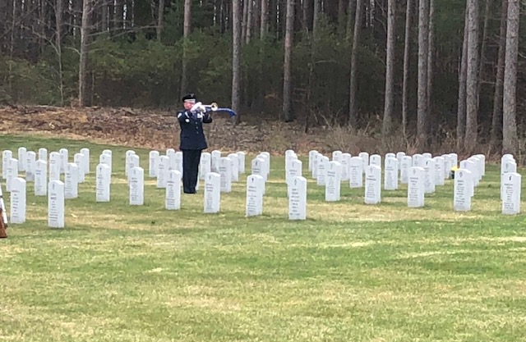
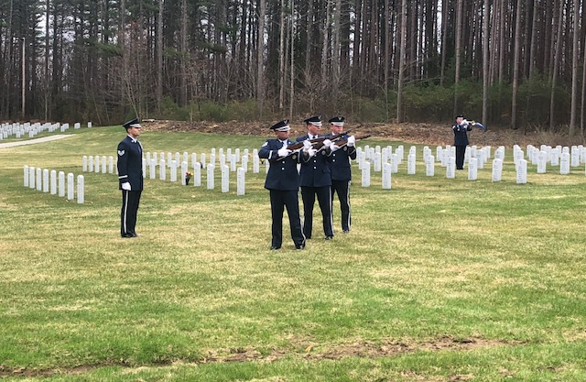
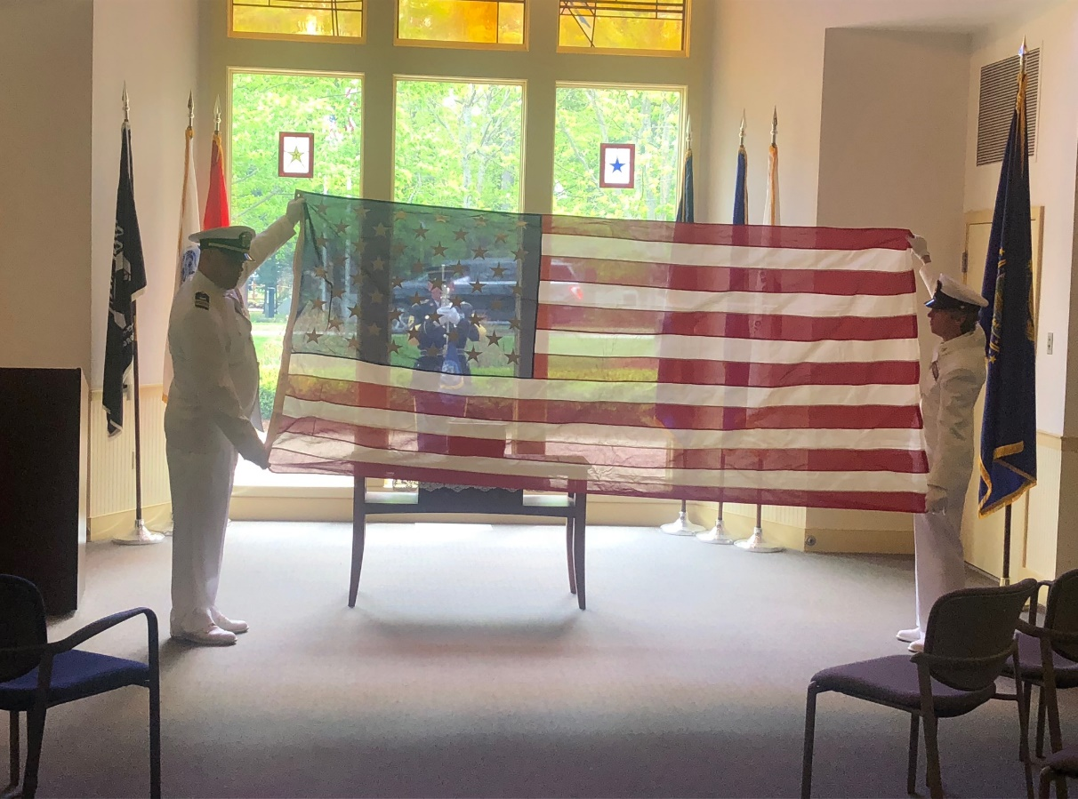
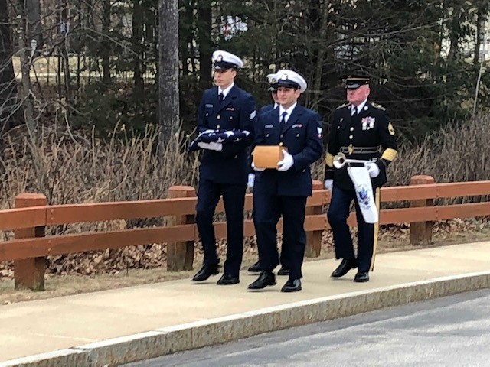
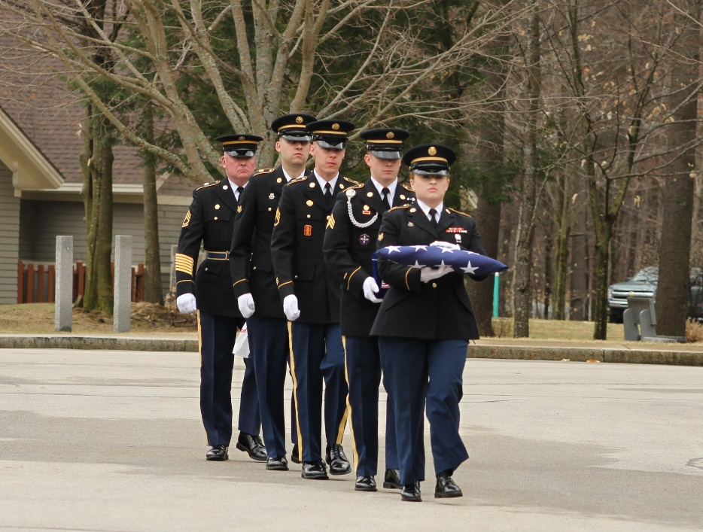

Slide 14
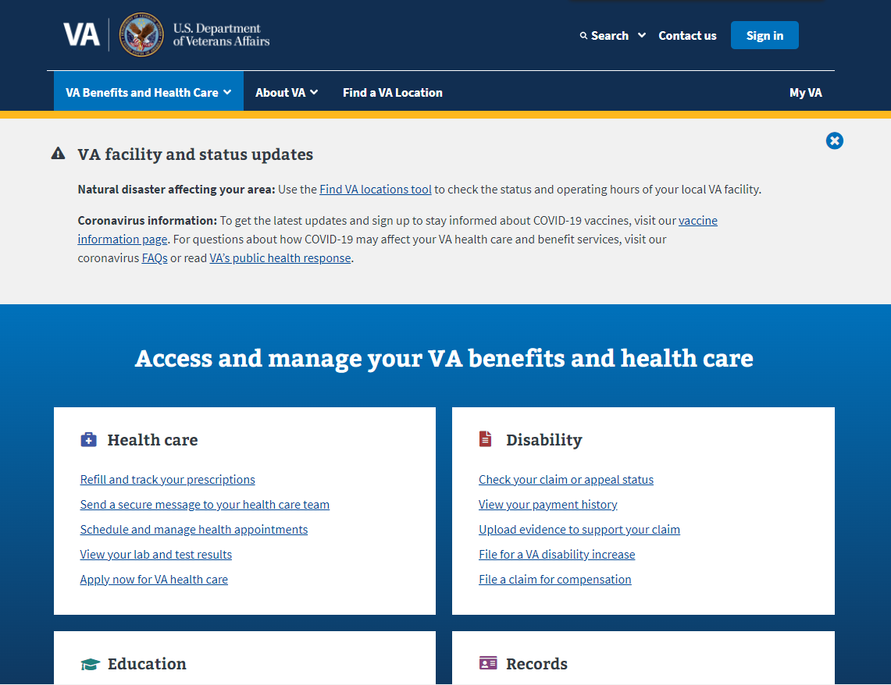
va.gov

Slide 15
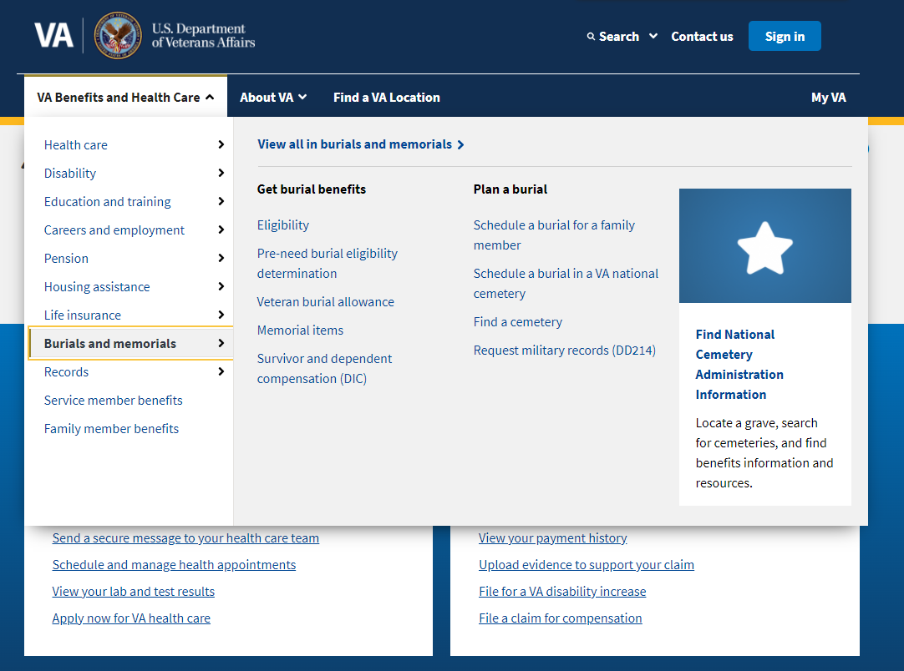

Slide 16
www.nhsvc.com email: info@nhsvc.com
www.nhvca.org (NH Veterans Cemetery Association)
email: info@nhvca.org
www.vhlc.org (Veterans Heritage Learning Center)
Facebook: NH State Veterans Cemetery
NH Veterans Cemetery Association
Twitter: @cemeteryNH
Instagram: nhvlc

Slide 17
Conclusion
NHSVC is a beautiful, peaceful place to visit
There are myriad learning opportunities:
  History
  Community
  Volunteerism
  Careers
Volunteer opportunities for all
A place of pride for NH

